Slide 1
A data analysis and machine-learning approach
Upasana Dhar
For analyzing texts

Slide 2
01
AIM
A
02
METHOD
B
4 Sections
03
RESULTS
C
04
D
CONCLUSION

Slide 3
01
AIM
A
Classifying texts from humans and machines
B
C
D

Slide 4
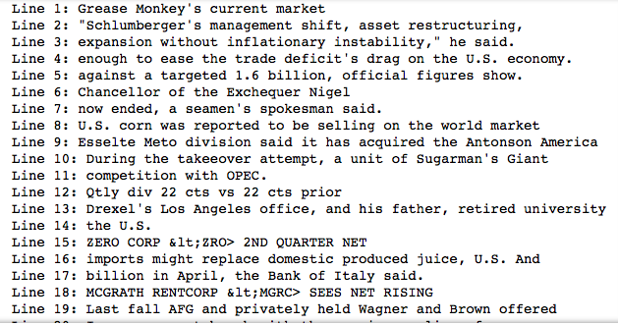
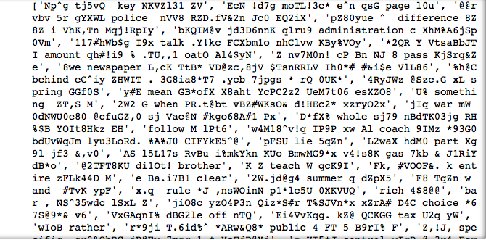
2 types of text:
Human text
Machine text

Slide 5
02
METHOD
A
B
Creating a binary label for both types of texts and classifying them using logistic regression and KNN
C
D

Slide 6
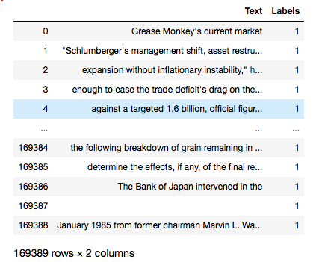
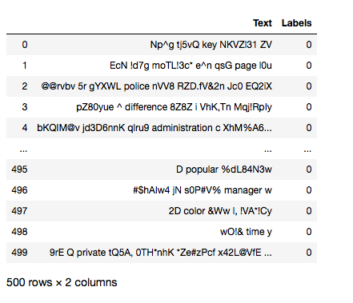
Two text dataframes combined to create the Training data for machine learning
Human text Dataset
Machine text Dataset

Slide 7
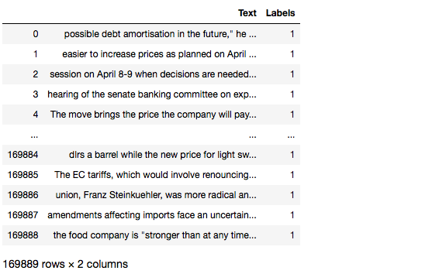
Final Training dataset consists of merged and shuffled data from two previous text datasets and classified into a binary file -Training data included the texts which was finally vectorized and converted to an array
Training text Dataset
LABELS

Slide 8
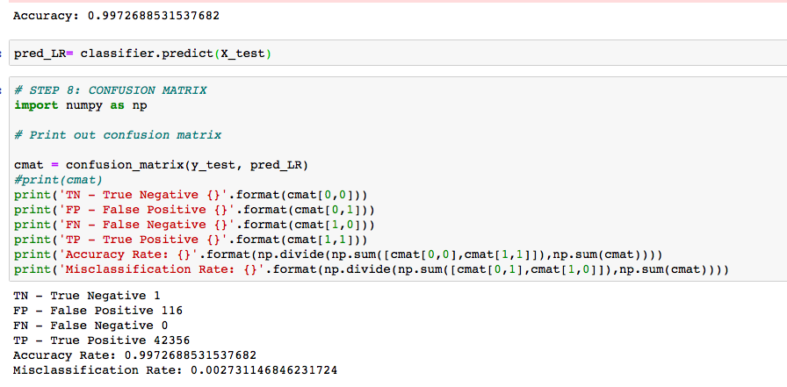
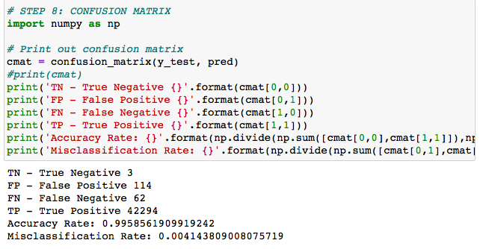
2 supervised Models accuracy:-
Logistic Regression
Model is biased
KNN

Slide 9
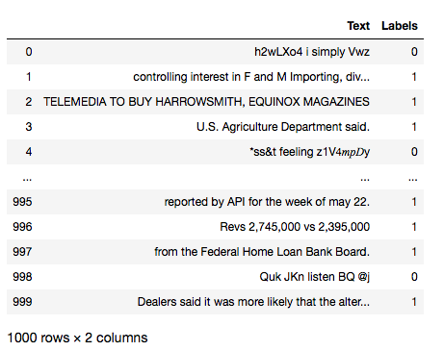
Training dataset was biased as more data points for human text and less for and machine, to overcome biasedness in New Training data, the human and machine text should be equal in size
Final Training text Dataset
LABELS
Size matters!

Slide 10
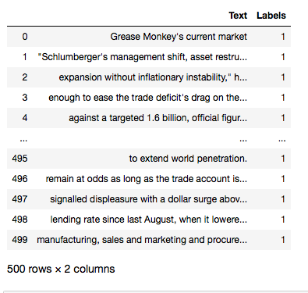
Two text dataframes
Human text Dataset
Machine text Dataset
Size matters!

Slide 11
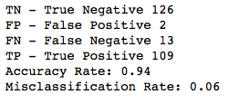
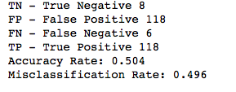
2 supervised Models accuracy:-
Logistic Regression
Final Model
KNN

Slide 12
03
RESULTS
A
B
Human and machine text calssified by Logistic regression model
C
D

Slide 13
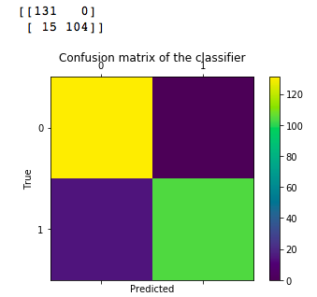
Logistic regression accuracy:- Confusion Matrix
Final Model-
The final training data used equal number of human and machine text data

Slide 14
04
CONCLUSION
A
Text classified using supervised machine learning model
B
In the first model, the training data consisted of more human text data than machine text data, hence it was biased
C
Training parameters controls the overfitting or biasness of the model,
hence needs to be efficiently tuned
to reduce biasness
D

